Slide 1
Genetic Algorithm: The Traveling Salesman Problem
Team Number: INFO6205_306
Team Member:
Heng Wang 001822598
Yize Wang 001822633
Dingting Huang 001824907

Slide 2
Given a set of randomly generated cities and a distance between each of them, there is a salesman whose job is to visit each of these cities and make a sell, he needs to plan a road so he can try his best to minimize his travel time and miles. He starts from his hometown and he will back to his hometown after work. We build a model based on sexual reproduction(not only crossover, also mutation).
Problem

Slide 3
Step 1
Create an initial population
Step 2
Evaluate the fitness
Step 3
Choose P/2 parents
Step 4
Create offspring using crossover
Step 5
Apply mutation
Step 6
Combine new generation with old one
Step 7
Determine gene is from new or not
Step 8
Evaluate the fitness
Step 9
Remove individuals with less fitness
Step 10
Repeat step 3, 4, 5, 6, 7

Slide 4
Every given point represents a city, an array of integers, it must be unique in a gene, and can't be duplicated.
Random combination between different points form a path
Decided by path length, f(g) = 1/w(g) where w(g) = (edge weights)
Genetic Code
Gene Expression
Fitness function
GA Thread
UI
For every co-evolution _begin class creates a separate thread with exemplar of GA<> class, using different crossover method(OX, OBX).

Slide 5


Mutation
OBX
Mutation
O X

Slide 6
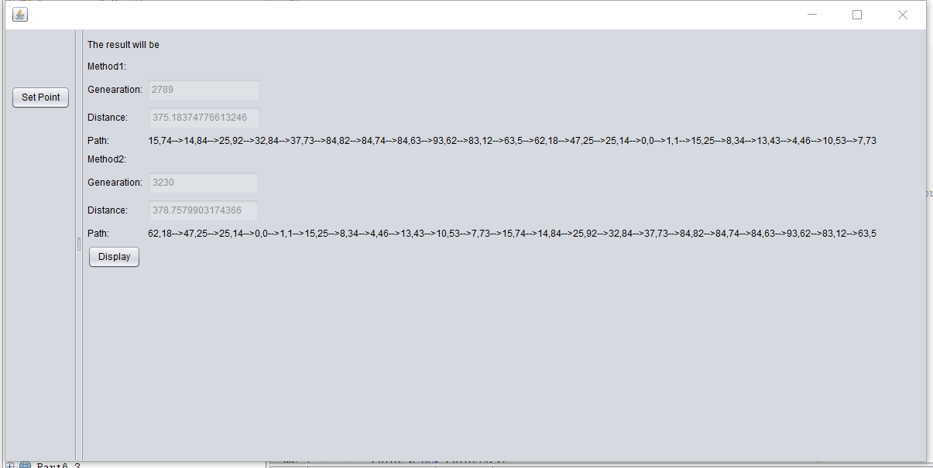

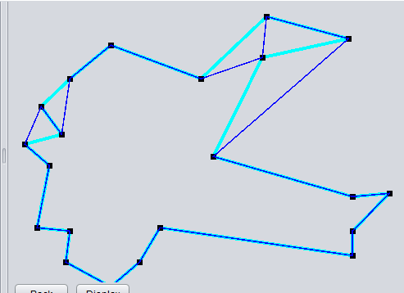

Slide 7
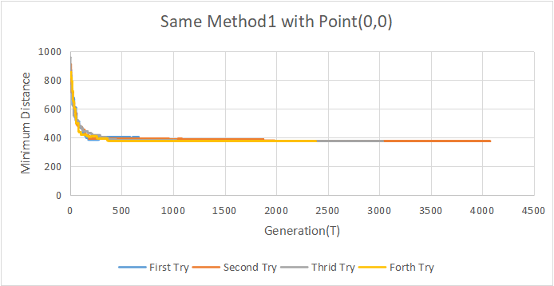
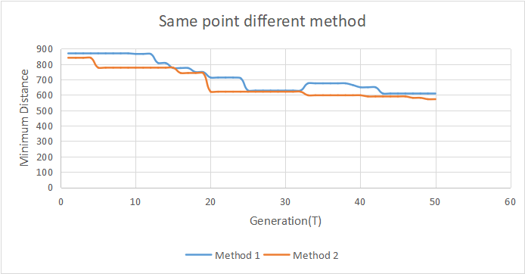
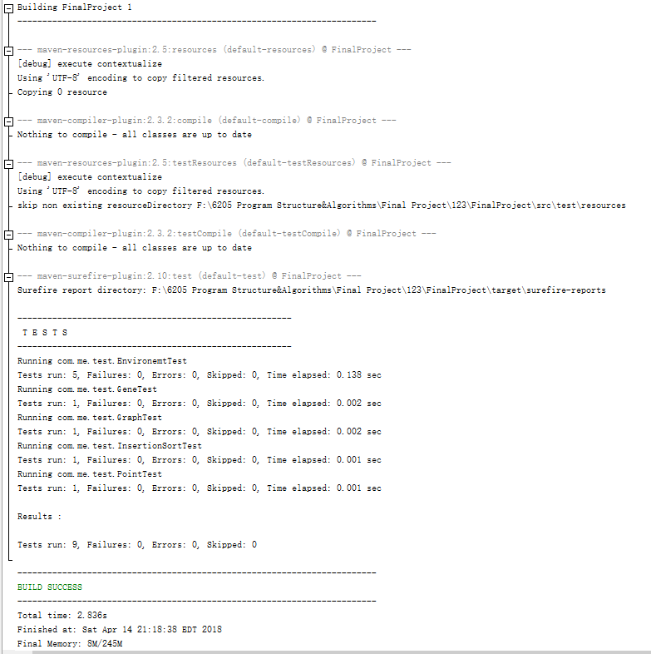
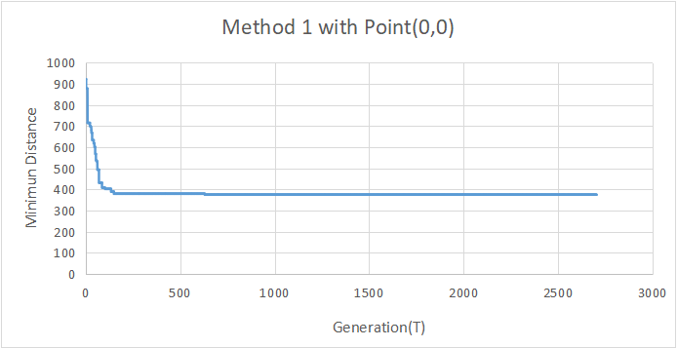
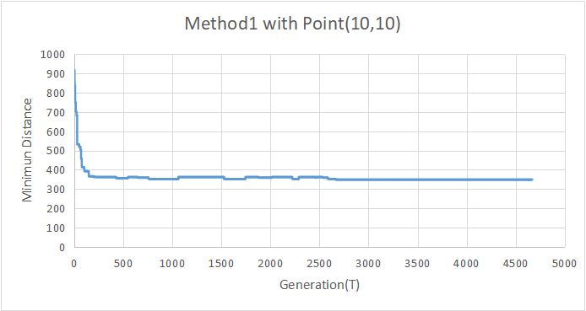
RESULT

Slide 8
Conclusion
Same point,
Same method
Same point, Different method
Different point, Same method
Program running results is very close and always get the best distance
We can find clearly the conclusion, the second method runs better than the first method
The greater the probability of the effective gene of a chromosome in the initial population, the higher the adaptability.

Slide 9
THANK YOU

